Slide 1
CONTENT PERSONALIZATION
Drupal Camp MA
January 19, 2013

Slide 2
INTRODUCTION
Drupal Camp MA

Slide 3
WHO AM I
Jason Yarrington
Vice President, Professional Services
Digital Bungalow
I have been working on web based marketing solutions throughout my career.
Psychology – Sociology – Statistician with the Census Bureau
Did my time at web startups in Boston
Worldstreet
Smartbargains
LifeOptions
At DB we focus on building engaging marketing web sites.
Notes:
My background is actually in Psychology and Sociology. From school I went to work at the Census Bureau as a Statistician

Slide 4
CONTENT PERSONALIZATION
Define the problem – making content more relevant to individuals
Have a goal
How do we implement this with Drupal

Slide 5
THE PROBLEM
Drupal Camp MA

Slide 6
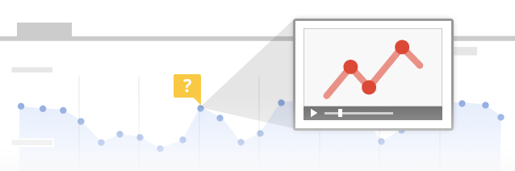
ENGAGING CONTENT THE PROBLEM
When looking at site traffic, most analytics are done in aggregate. The aggregate results show us how the “Average User” engages with the site.
However, understanding analytics and content needs in aggregate is no more useful then utilizing the average temperature for a year in deciding what clothes to wear on a given day.
As a result, most websites don’t feel very smart to the user.

Slide 7
CONTENT PERSONALIZATION
The Wor
Notes:
To get to more meaningful information we segment the data. We know in analytics that we can get more accurate information if we can group people into common groups or segments. We aren’t all the same, but we are like a lot of other people.

Slide 8
ENGAGING CONTENT TARGETTED CONTENT
WE DESIGN FOR PERSONAS
The products we sell are designed for specific people
Clothes for men, women, infants, children
Cars for environmentally conscious, trucks for middle age tech executives that wish they spent more time outdoors
Content is designed for specific people
Blog articles based on interest
Technical articles for the computer programmer
Business articles for the project manager
Design articles for the UX person

Slide 9
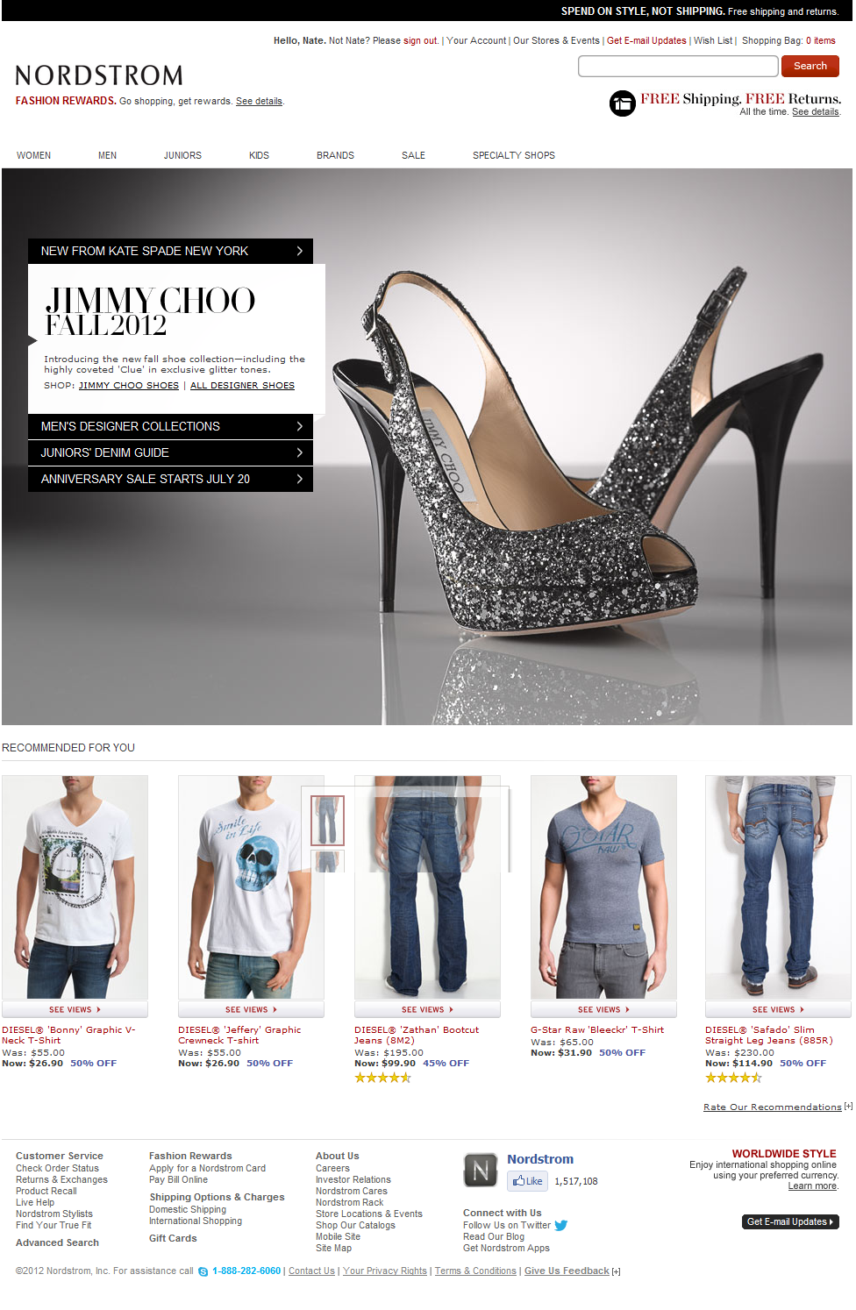
WEB ENGAGEMENT MANAGEMENT NORDSTROM
Example:
Nordstrom.com
Homepage
Use Case:
Semi-Frequent
Male Shopper
(cookied)
Not Smart!
Smart!
Notes:
We use this example a lot when explaining this to people. Our CEO is a fairly fashion forward guy in his late 30s.

Slide 10
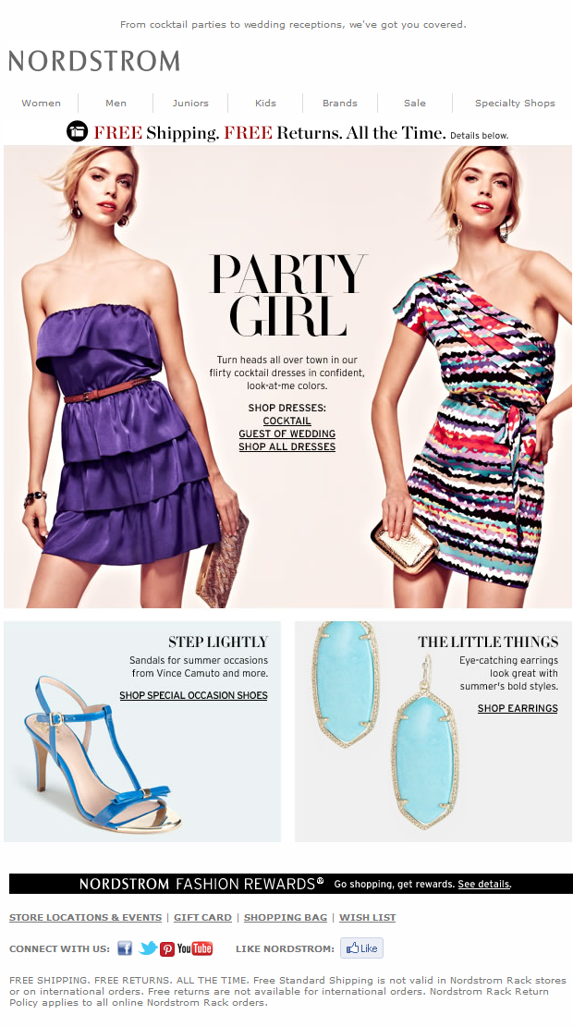
WEB ENGAGEMENT MANAGEMENT NORDSTROM
Example:
Nordstrom Email
Marketing
Use Case:
Semi-Frequent
Male Shopper
Wasted Impression
=
Not Smart!
Notes:
How about this for an email. Totally appropriate to me!

Slide 11
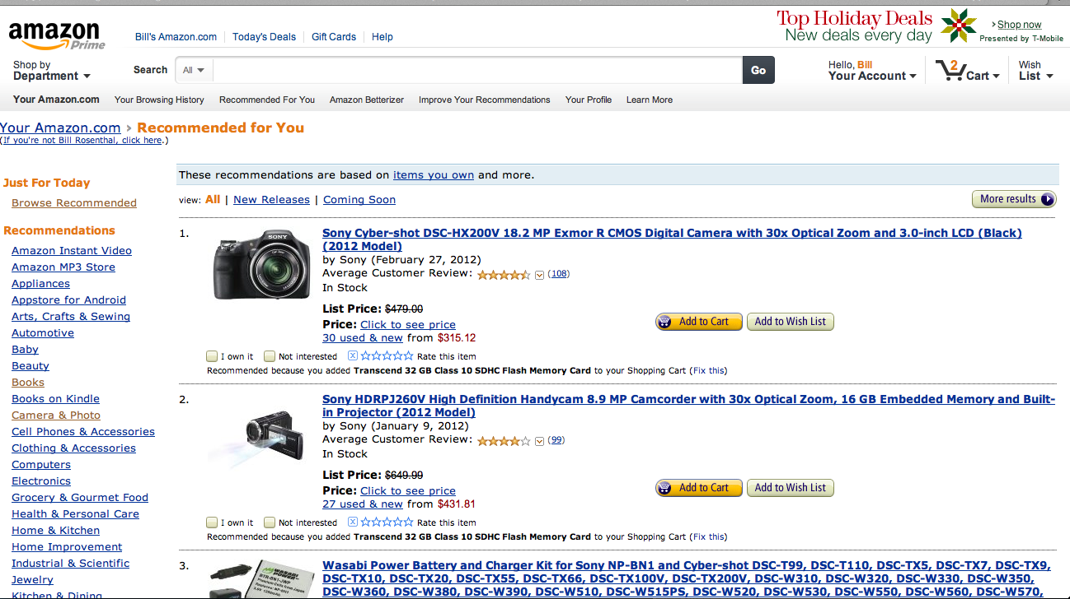
DATA DRIVES ANYTHING AMAZON
Notes:
But some people do this well. Amazon has been the king of this. They have products for everyone. They are not targetted at any one group. But somehow, so many of us go there over and over. Marketers and brand managers thought this would never work. It works, because despite their variety, they always are figuring out how to show me stuff I am interested in. They have too many books and products for me to explore and find things.

Slide 12
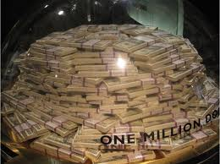
NETFLIX REAL MONEY IN THE GAME
NETFLIX CINEMATCH
In 2009 Netflix ran a contest to see if developers could create algorithms that were better than there’s at predicting someone’s ratings based on a training data set of ratings.
The goal is to see if an algorithm can better predict whether someone will like a movie based on previous ratings.
If someone could make a 10% improvement, there was a prize

Slide 13
PERSONALIZED RECOMMENDATIONS NETFLIX

Slide 14
GETTING UNREAL
When we put a site together, even if we narrow in on a segment or persona, there is still a lot of variety in interests for people of those ages.
But the good news is, they want to tell us their interests
Notes:
All set

Slide 15
WEB ENGAGEMENT MANAGEMENT
The promise
If we present users with content that fits their preferences will they be more likely to return?
If the visual elements of the site respond to the user will they relate to the site and content more?

Slide 16
MARKETING 101
Drupal Camp MA

Slide 17
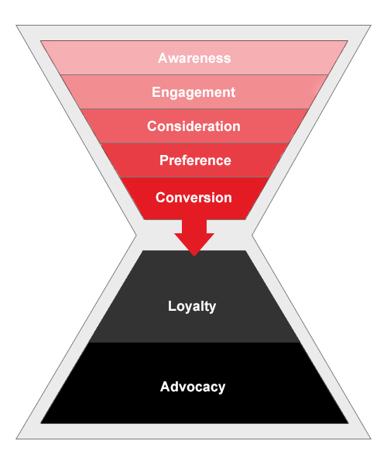
MARKETING BACKGROUND
A little marketing 101 the way we think about it.
AWARENESS: How do I make you aware of my product or service.
ENGAGEMENT: Now that you know about my product and service, how do I get you to learn more.
CONSIDERATION: You know a lot more now, how do I get you nudged towards making a decision to purchase.
PREFERENCE: This is very close to consideration. But, it’s a preference for my brand over another. Do you want my product or service rather than my competitor.
CONVERSION: Time to purchase.
LOYALTY: Come back and purchase again.
ADVOCACY: Recommend our product or service to another person
Notes:
All set

Slide 18
MARKETING BACKGROUND
Can we make a site more engaging?
AWARENESS: How do I make you aware of my product or service.
ENGAGEMENT: Now that you know about my product and service, how do I get you to learn more.
CONSIDERATION: You know a lot more now, how do I get you nudged towards making a decision to purchase.
PREFERENCE: This is very close to consideration. But, it’s a preference for my brand over another. Do you want my product or service rather than my competitor.
CONVERSION: Time to purchase.
LOYALTY: Come back and purchase again.
ADVOCACY: Recommend our product or service to another person
Notes:
All set

Slide 19
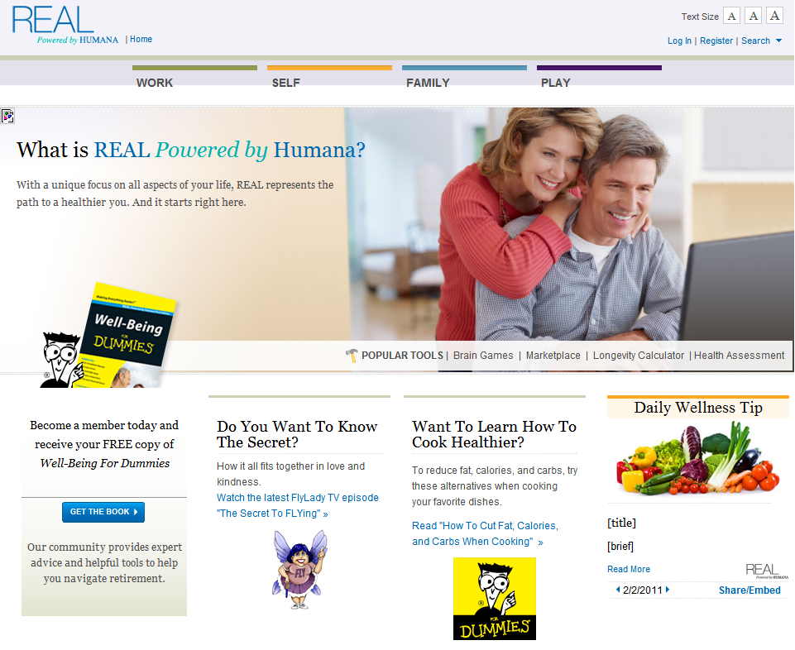
CASE STUDY
Realforme.com
Popular health and wellness site with content from over 20 bloggers.
But everyone sees the same content, regardless of who they are.
Login is just a sort of pay wall. There is no advantage to me to joining this site.

Slide 20
CASE STUDY – MyWell-Being.com
Drupal Camp MA

Slide 21
Humana Program Background
Realforme.com was a successful acquisition program.
Over 370,000 members had signed up through a very successful multi-channel online and offline campaign over three years.
Members of the site were much more likely to become—and stay—Humana subscribers.
The program was awarded Best Web-Based Customer Retention and Loyalty Campaign by the CMO Council
But, we don’t see people come back often.
Notes:
Jason Y and Andy
Humana is the nations largest provider of
Market-Bridge and Digital Bungalow had
One of the country's largest Medicare providers and a top health insurer, Humana provides Medicare Advantage plans and prescription drug coverage to more than 4.5 million members throughout the US. In the Medicare market, private insurers cannot market directly to customers until they reach the age of eligibility. Marketbridge and Digital Bungalow worked together to create a program to drive brand affinity in people ages 45 to 65.
The program was a multi-channel marketing campaign with a website at the hub. The website, realforme.com featured articles by prominent bloggers in the subject areas (or pillars) of Health, Self, Family, and Play.
The program was extremely successful. At the end of three years, over 370,000 people had signed up for the site
When Andy and his team analyzed the purchasing behavior of site subscribers, they found that they were much more likely to become and stay Humana subscribers
And, they program was awarded the Best Web-Based Customer Retention and Loyalty Campaign by the CMO council.

Slide 22
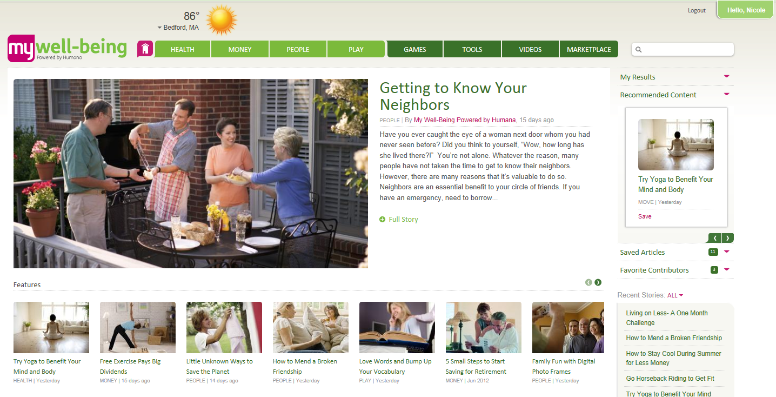
ENGAGEMENT STRATEGY
DEFAULT VIEW
Segment Attributes:
Brand new visitors to the site with no click activity
Users who have yet to be modeled
WEM Output: Default version of the page
Notes:
Jason
So, let me show you the finished product and what this looks like to the user. When you first come to the site, you are going to see the same thing any new user would see.
A featured article in the hero image. This is updated weekly to keep it fresh. Sort of the traditional publishing model. And the feature blocks in the next row have content from each area of the site. The user is presented with a pretty even distirbution of content from different subject areas.

Slide 23
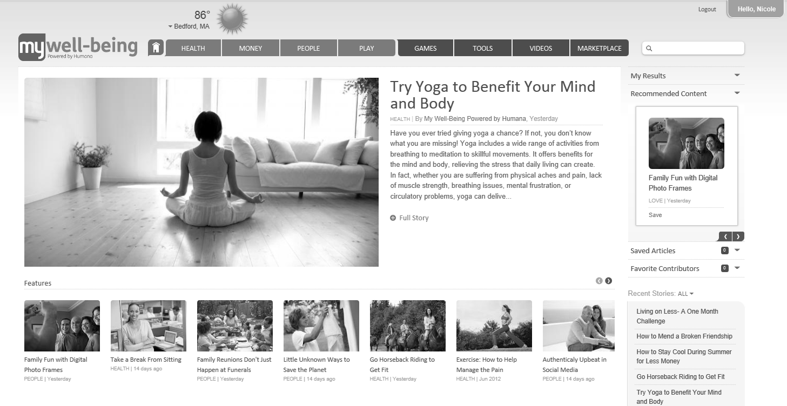
ENGAGEMENT STRATEGY
HEALTH SEGMENT
Segment Attributes
Demographics: Male or Female, Under 60
Tracked Site Activity: Users who have predominantly clicked on health related content.
WEM Output: Web and email featured content is weighted toward new health content.
Notes:
Jason
After you tell us a bit about yourself we start showing you more content relevant to your preferences.
This user is in a segment of male or female under 60. The user has shown they are predominantly interested in health related content.
We feature web and email content weighted towards new health content.
So, one of the things I mentioned there is that we are now taking this beyond what the user told us in their profile. All the content in the site is tagged to a category. Based on the user’s engagement, we start featuring content based on their behaviour. Not just on what they told us, but on what they are actually doing.
You ever notice when you buy a car, you see other people driving that car everywhere. People thought this might seem creepy, but it’s not. It’s actually what engaged web users expect. We see this throughout media and retail. If you use the music service Pandora, the channels are setup by you telling the site a song you like, it recommends content for you. When you go to Netflix streaming, the primary nav item is suggestions for you based on what you have watched and what you have rated.

Slide 24
ENGAGEMENT
RETIREE SEGMENT
Segment Attributes
Demographics: Male or Female, Age 60+
Tracked Site Activity: Users who have predominantly clicked on retirement related content.
WEM Output: Web and email featured content is weighted toward new retirement, leisure, & finance content.
Notes:
Jason
So, this segment is – read from slide

Slide 25
CASE STUDY
FAMILY SEGMENT
Segment Attributes
Demographics: Female, Age 30-60
Tracked Site Activity: Users who have predominantly clicked on Family & Social content.
WEM Output: Web and email featured content is weighted toward new Family & Social content.
Notes:
Jason
So, this segment is – read from slide

Slide 26
ENGAGEMENT
RESULTS
WEM has been a huge success. User engagement is up across:
Total visits: 36%
Unique visitors: 46%
Page views: 72%
Visit duration: 74%
Our client is thrilled!
This project is a shining example of our ability to innovate beyond what we thought was possible, and to craft new technology that delivers on our vision.
Notes:
Andy –
Turn over to Andy. I think our client is on the webinar today.

Slide 27
ANOTHER EXAMPLE
Drupal Camp MA

Slide 28
MARKETING BACKGROUND
Can we make a site more engaging?
AWARENESS: How do I make you aware of my product or service.
ENGAGEMENT: Now that you know about my product and service, how do I get you to learn more.
CONSIDERATION: You know a lot more now, how do I get you nudged towards making a decision to purchase.
PREFERENCE: This is very close to consideration. But, it’s a preference for my brand over another. Do you want my product or service rather than my competitor.
CONVERSION: Time to purchase.
LOYALTY: Come back and purchase again.
ADVOCACY: Recommend our product or service to another person
Notes:
All set

Slide 29
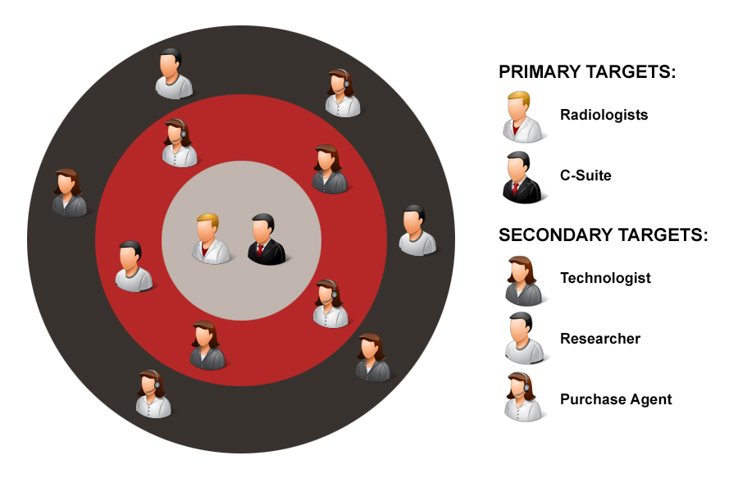
BREAST TOMO TARGET MARKETS
In order to convey a personalized experience for each user group on the website, we will create strong calls to action and highlight relevant content for the primary target markets.
Notes:
All set

Slide 30
3-D MAMMO CAMPAIGN PRIMARY TARGET MARKET
The website will focus on reaching the following two target markets:
C-Suite
Radiologists
While they have varying degrees of informational needs, interests, and user goals while on the site, they must both be pushed through each step in order to take the ultimate action of conversion (Contact Us form).
Notes:
All set

Slide 31
Notes:
All set

Slide 32
Notes:
All set

Slide 33
BREAST TOMO WHAT IS WEM?
Medical device sales require the development of highly targeted quality content to help purchase influencers and decision makers alike understand the benefits of the product.
Web Engagement Management (WEM) is the practice of customizing and personalizing website content for users to make the website experience more relevant and compelling. This encourages users to spend more time on the site and to be presented with more relevant content on each visit.
In order to do this, we determine visitor segments and set up visitor scoring modules, dynamic content, and analytics, in accordance with the user and business goals for the site.
Notes:
All set – Made changes

Slide 34
APPROACH
Drupal Camp MA

Slide 35
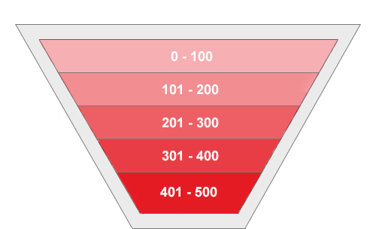
BREAST TOMO WEM STRATEGY
Users to the site will be analyzed on two axis:
Engagement Level
User Type
How engaged a user is with the site and brand measured by the quantity and quality of their interactions
Based on what content the user interacts with, we will categorize the user into the target segments
Notes:
Jason to add a little more explanation.
The average influencer or purchase decision maker visits a website (xx) times before being ready to consider a purchase. On average, users are 80% of the way to making a purchase before they are ready to talk to a sales person. With this many visits to the website, we should take advantage of that.

Slide 36
TRACKING AND SCORING
User engagement will be a measure of all the user’s prior activities on the site.
User engagement will be tracked via pre-determined site actions.
The content for these actions will have established values which will reflect the weight each action has on the user’s overall engagement level.
Upon completion of any one action, the point value will be added to the user’s overall engagement score.
Engagement Scoring
Action | Content/Asset | Point Value
View… | Page Video | 1 20
Download… | PDF | 50
Click… | Promo Tile | 25
Conversion
Notes:
Jason to review

Slide 37
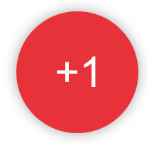
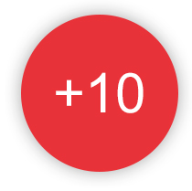
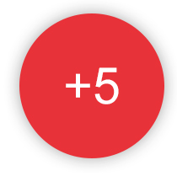
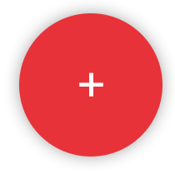
ENGAGEMENT-BASED USER PATH
This is Tim.
When Tim…
…visits the website, we give him a point.
…downloads a white paper, we give him 10 points.
…watches a video, we give him 5 points.
…and reads articles, we give Tim even more points.
Methodology: Once Tim reaches a certain engagement score, we move him into the next engagement tier or segment.
Result: Tim will now receive content specified for his particular engagement level.
Notes:
All set

Slide 38
PERSONALIZATION USER TYPE
Role categorization is based on the type of content the user interacts with most.
Individual content pieces will be tagged with one or more role types.
When a user accesses a piece of site content, the user will be given a point towards that particular role.
Upon reaching an initial threshold of at least one standard deviation from another role, they will be assigned a role.
The user will then be served content developed specifically for their user type.
Radiologist
C-Suite
Notes:
Jason to review

Slide 39
BREAST TOMO ROLE-BASED USER PATH
This is Craig.
When Craig…
…reads an article tagged for radiologists
…downloads a white paper tagged for radiologists
…watches a video tagged for radiologists
…lands on a page tagged for radiologists, we give Craig a point towards that particular user role.
Methodology: Once Craig receives 15 initial role points, we will assume, with a high degree of confidence, that Craig is a radiologist.
Result: Craig will now be targeted with specific content for that role.
Notes:
All set

Slide 40
BREAST TOMO WEM CONTENT PLACEMENT
The following real estate will be utilized on the homepage to personalize the experience for the user’s role and engagement level.
Role-Based Content
Role-Based Content
Engagement-Based Content
Notes:
All set

Slide 41
THE CODE
Drupal Camp MA

Slide 42
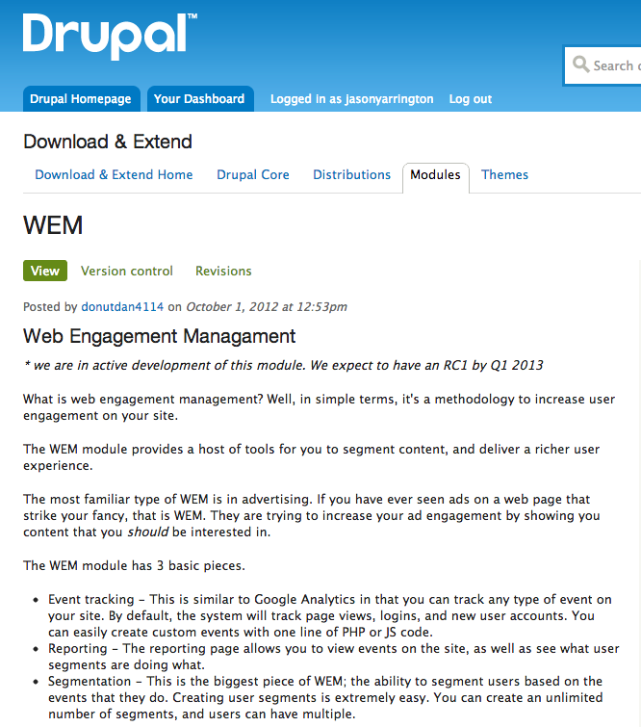
Web Engagement Module
http://drupal.org/project/wem
Initially we did this all with custom code.
We took the practices we did in this project and abstracted them into the WEM module.
Notes:
Jason
- Drupal had what we needed for personalization and it allowed us to extend the tools. Some of what we needed didn’t exist yet, so we had to build it. And, like good members of the community, we were excited to contribute our framework back.

Slide 43
PROJECT/WEM
KEY FEATURES
This module allows you to track user events as they occur throughout the site. By doing this, you are able to customize a user's experience to be unique.
The Engagement module can utilize the Google Analytics module to help track events. Any event that you track in this module can be sent to Google Analytics.

Slide 44
ENGAGEMENT API
ENGAGEMENT API
The Engagement module tracks a user's page views and profile updates by default. You can create custom events very easily in PHP and JavaScript.
Track custom events - In PHP:
engagement_event_track($event_name, $event_value = NULL, $event_data = NULL, $uid = FALSE);
In JavaScript:
Drupal.engagement.track(event_type, event_value, event_data);
In HTML:
You can track events on any HTML element by using the data-engagement attribute.
To streamline the process, you must use the engagement_data_attribute($event, $value, $data, $bypassQueue) function.
<a href='#' <?php echo engagement_data_attribute(array('click'), 'submit_form', 'registration_form'); ?>></a>
This 'a' tag will automatically be tracked on it's click event with the inserted event attributes.

Slide 45
WEM
EXAMPLES
Let's say we want to change a user's site experience based on the articles they read.
We could make a tag pool of the articles that they view.
First, let's set custom tracking based on tags. In your hook_page_build():
// Get the tags for this article.
$n = menu_get_object();
$tags = $n->field_tags[$n->language];
$tag_array = array();
foreach($tags as $tag){
$tag_array[] = $tag['tid'];
}
engagement_event_track('article_view', current_path(), array('tags'=>$tag_array), $user->uid);

Slide 46
WEM
QUERIES
The Engagement module comes with easy-to-use functions for doing common querys. Doing a custom query is easy too because all data is stored locally.
$events = engagement_get_events('article_view', NULL, NULL, $user->uid);
$tags = 0;
foreach($events as $event){
// Count tags and put in array.
foreach($event->data['tags'] as $tag){
$tags[$tag]++;
}
}
We now have a user's total engagement for all tags in the $tags array.
We can customize content for the user with this information.

Slide 47
WEM
PERSONALIZING CONTENT
We now have a user's total engagement for all tags in the $tags array.
We can customize content for the user with this information.
if($tags['tech'] > 100){
// Give user the 'tech' badge or something..
}
In JavaScript, we could track when a user hovers over a certain link:
Drupal.engagement.track('mouse_hover', 'secret_button', hover_time);
If you have the Google Analytics module enabled, these events are automagically sent as custom Google events.

Slide 48
WEM
TRACK NODES

Slide 49
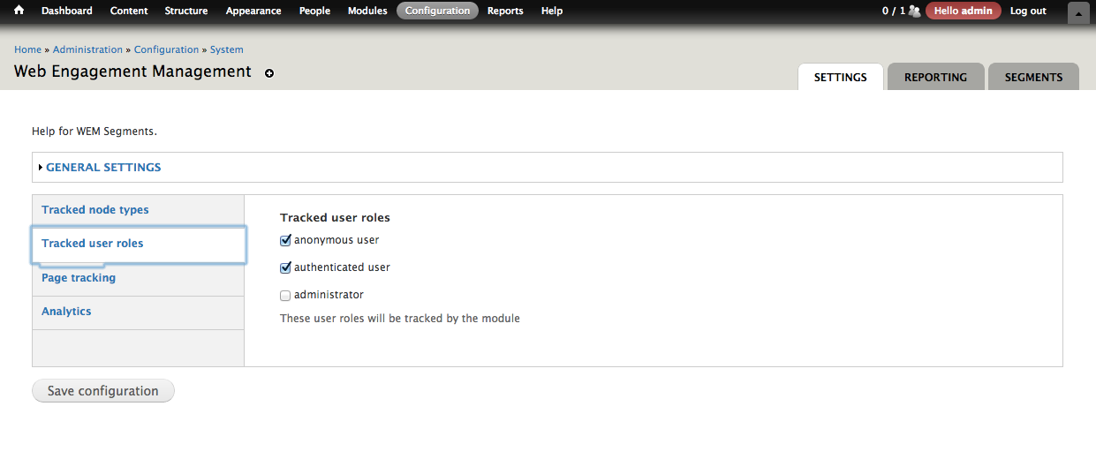
WEM
TRACKED USER ROLES

Slide 50
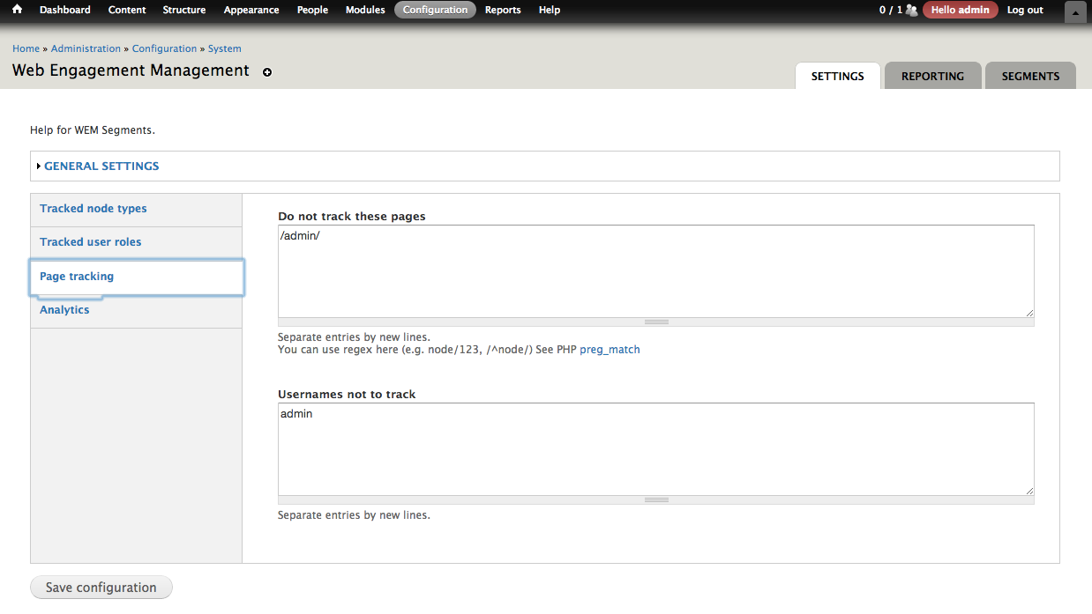
WEM
FILTER WHAT PAGES TO TRACK

Slide 51
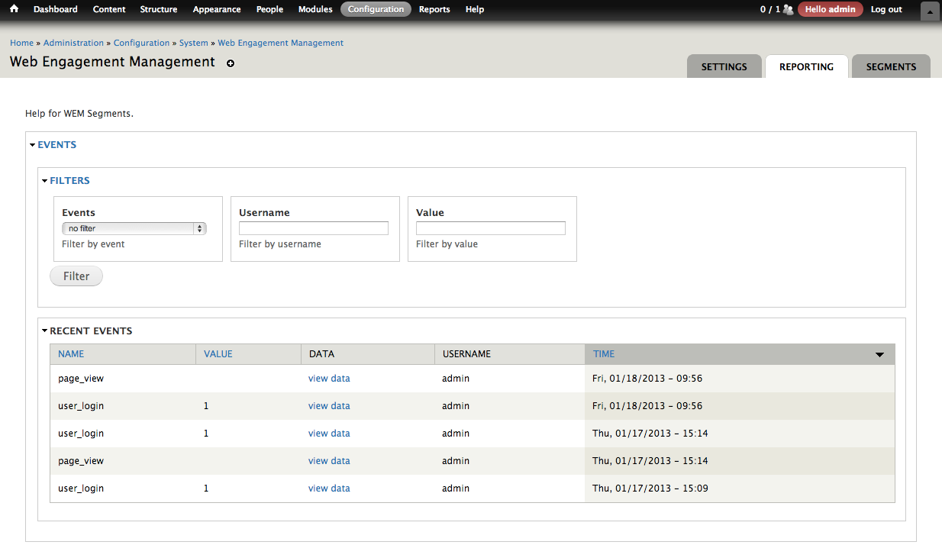
WEM
REPORT ON TRACKED EVENTS

Slide 52
WEM
CREATE SEGMENTS

Slide 53
WEM
CREATE SCORING RULES ON EVENTS

Slide 54
WEM
COMPARISON SEGMENTS

Slide 55
WEM
CREATING SEGMENTS

Slide 56
AUTOMATING THIS
RECOMMENDER API
Recommender API implements various algorithms to build recommender systems. It provides easy-to-understand, easy-to-use, fully-documented APIs for other Drupal content recommendation modules (See a list below). It also provides a unified approach to configure & execute the recommender algorithms, and to display results to end users.

Slide 57
AUTOMATING THIS
Recommender API can take your viewers behavior to recommend additional content
Browsing History Recommender: "Users who browsed this node also browsed"; personalized node recommendation based on users' browsing history.
Commerce Recommender: Personalized products recommendations based on customers purchasing history.
OG Similar groups module: "Users who joined this group also joined"
Ubercart Products Recommender: "Customers who ordered this also ordered" and personalized recommendation "Recommended for you"
Fivestar Recommender: User-to-user and Item-to-item (used in Amazon.com) recommendations for Fivestar module.
Points Voting Recommender: User-to-user and Item-to-item (used in Amazon.com) recommendations for Up/Down and Plus 1 modules.
Flag Recommender: Recommender for the Flag module.

Slide 58
THANK YOU
Jason Yarrington
@jasonyarrington
jyarrington@digitalbungalow.com

